Slide 1
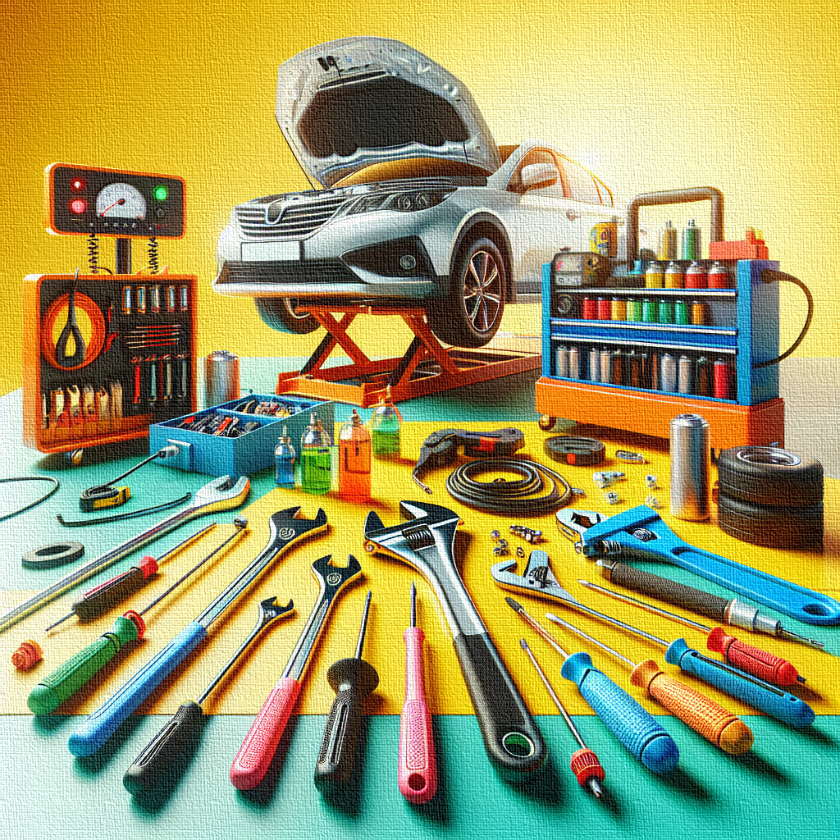
VEHICLE
MAINTENANCE
Hasnaa Bodulavagothi
Data Analyst
Tableau

Slide 2
INTRODUCTION
Vehicle maintenance is the regular care and servicing of a vehicle to keep it in good working condition.
It helps in improving vehicle performance, ensuring safety, and increasing the life span of the vehicle.
Proper vehicle maintenance helps to prevent unexpected breakdowns and reduces repair costs.

Slide 3
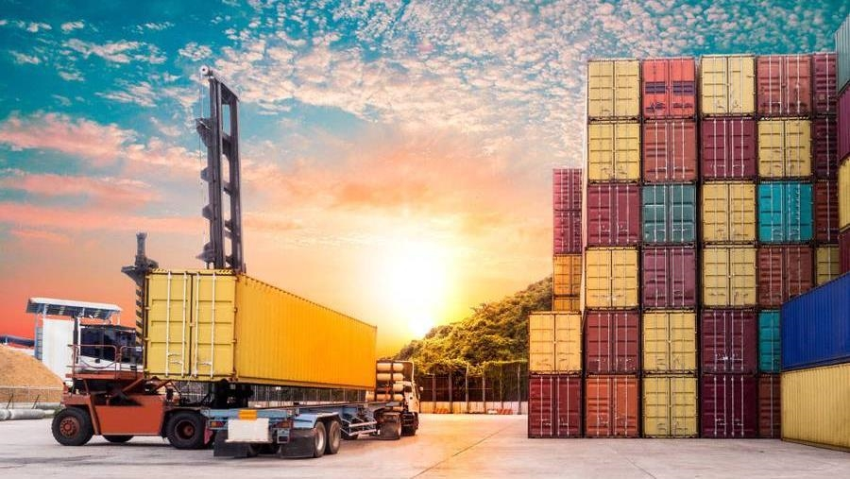

OBJECTIVES
To analyze vehicle maintenance data and identify vehicles that require maintenance.
To understand the frequency of maintenance based on vehicle usage and condition.
To compare maintenance status across different vehicles.
To identify patterns that indicate when maintenance is needed.

Slide 4
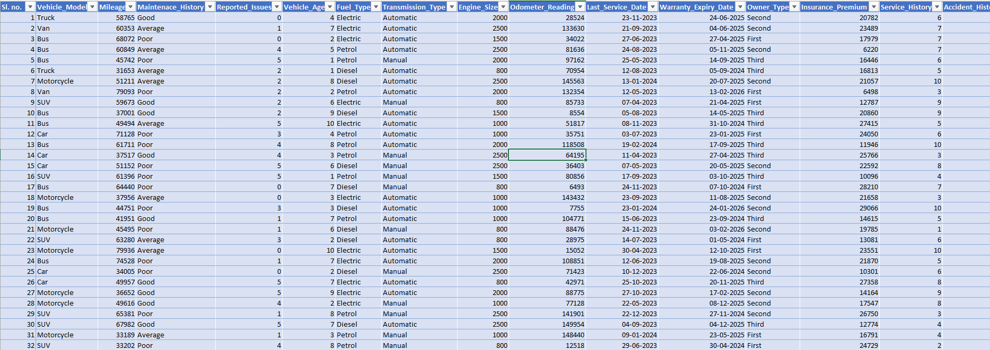

Slide 5
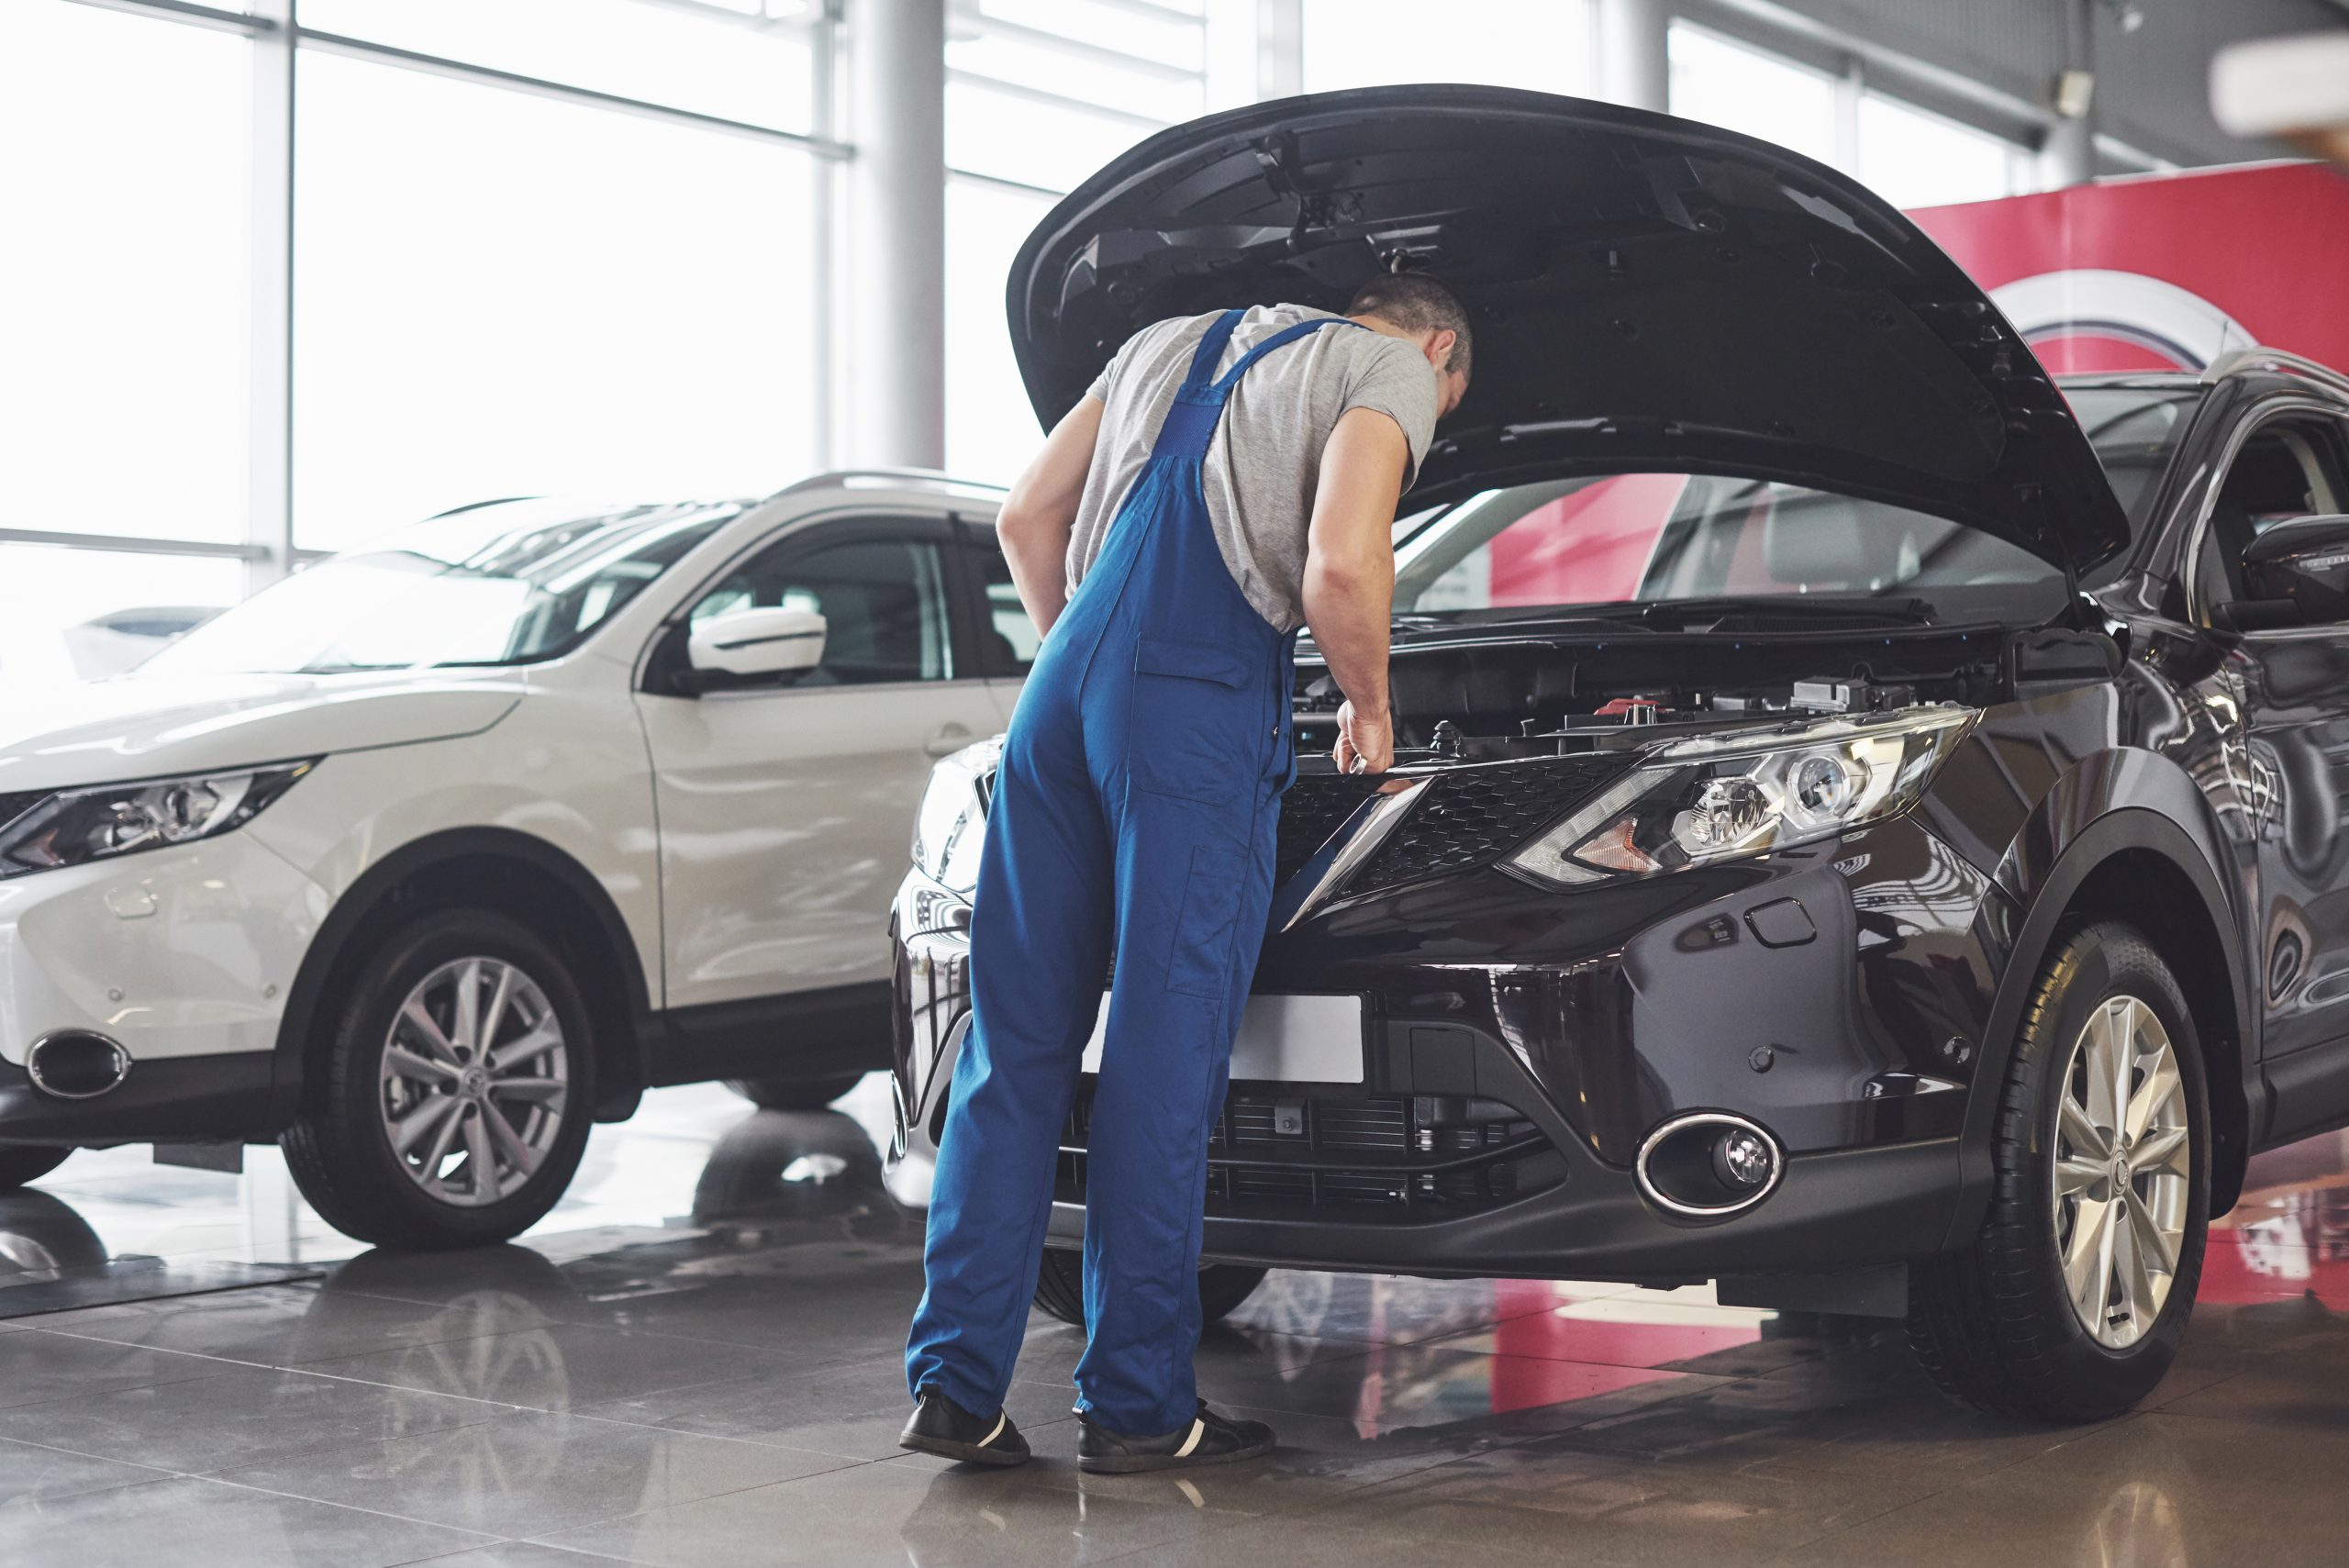
CRITERIA
________________________________
Vehicle category distribution by mileage – Tree map
Fuel type distribution – Pie chart
Usage distribution – Bar chart
Owner type – Horizontal Bar chart
Vehicle condition overview – Bubble chart
Car type – Lolipop chart

Slide 6
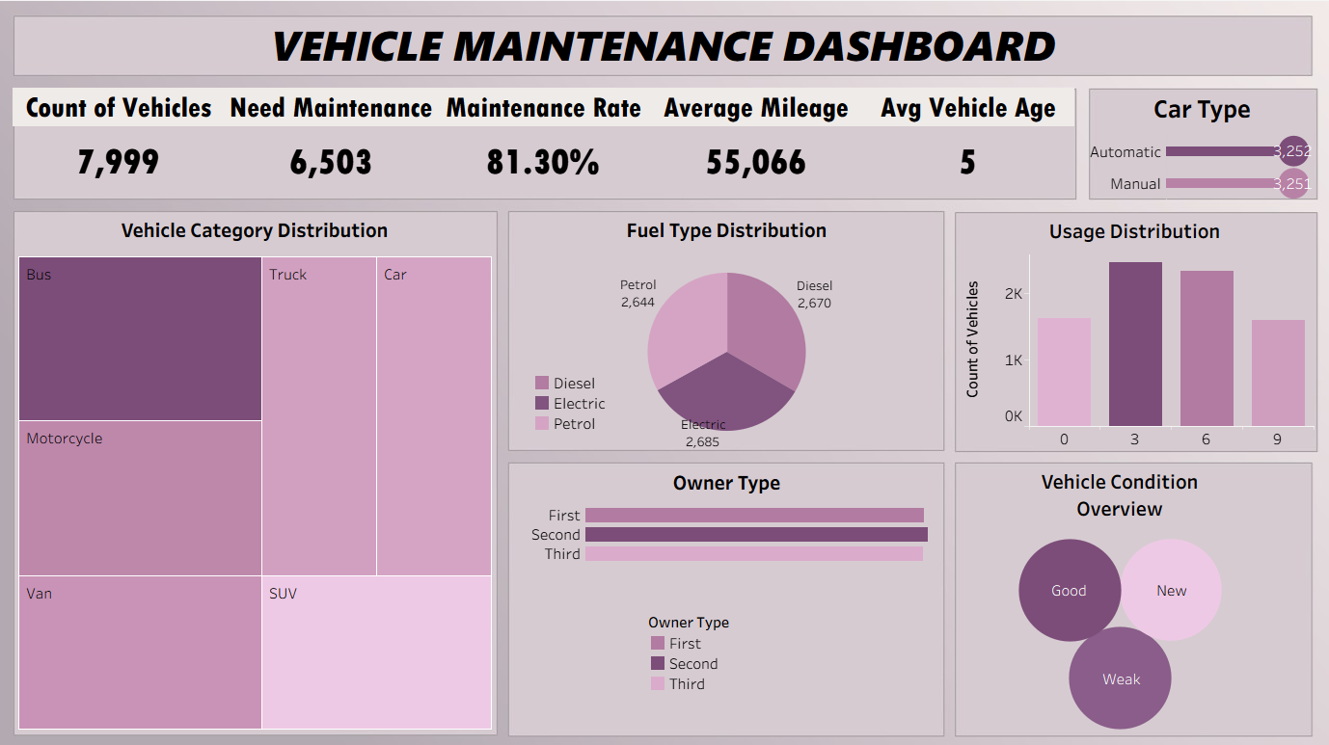

Slide 7
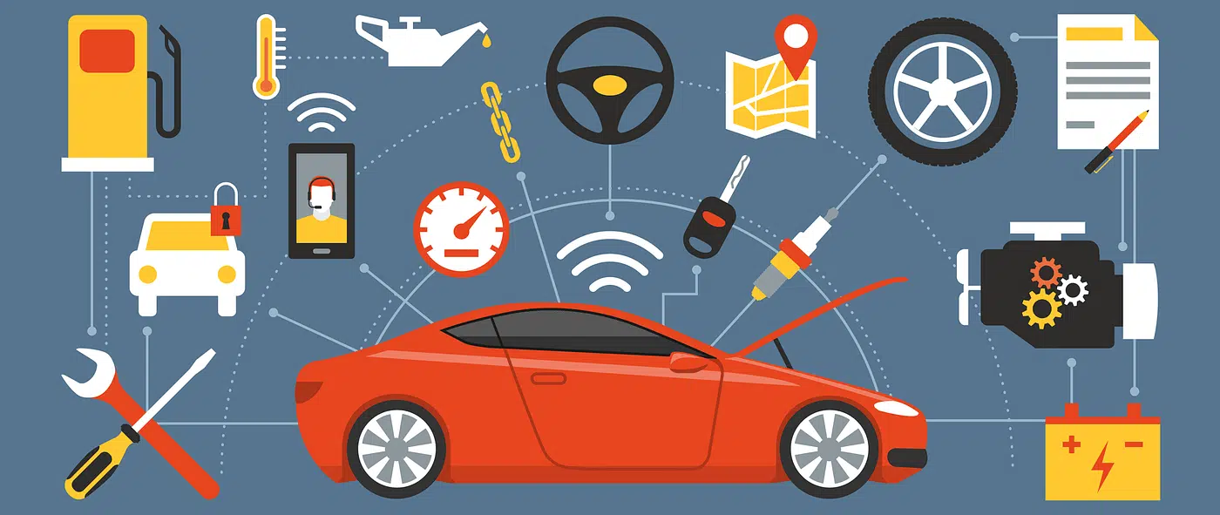
CONCLUSION
____________________________________________________
The charts clearly show that vehicles with higher mileage, poor condition, and delayed servicing require maintenance more frequently.
It proves that proper analysis and regular maintenance can increase vehicle life, improve operational efficiency, and support better management decisions.

Slide 8
REFERENCE
https://www.kaggle.com/datasets/chavindudulaj/vehicle-maintenance-data
Tableau

Slide 9
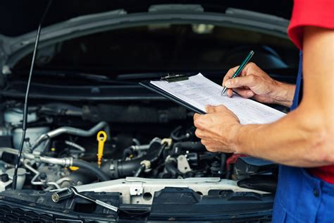
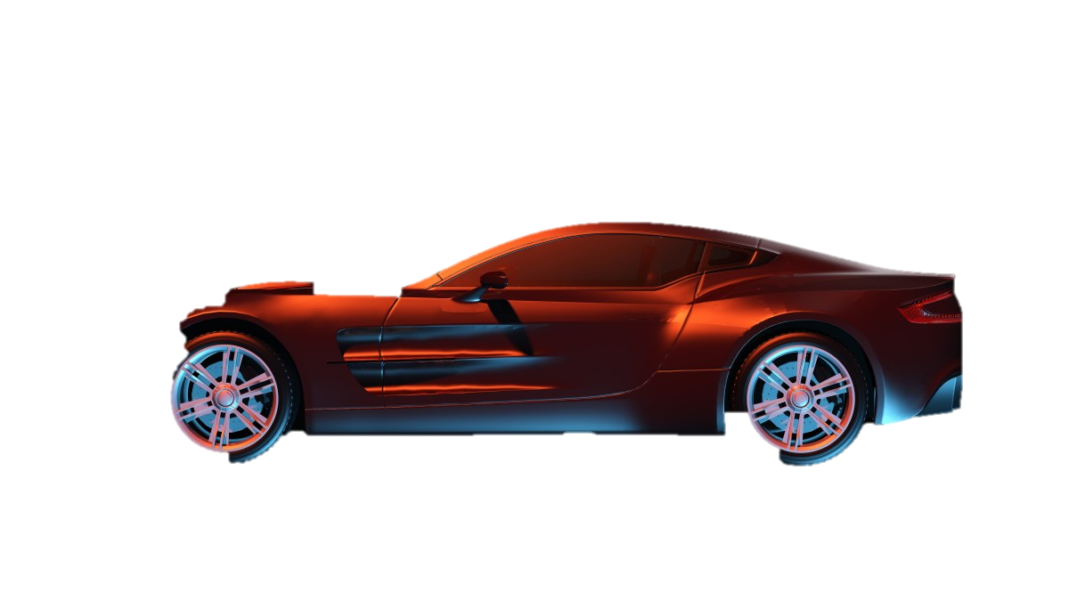
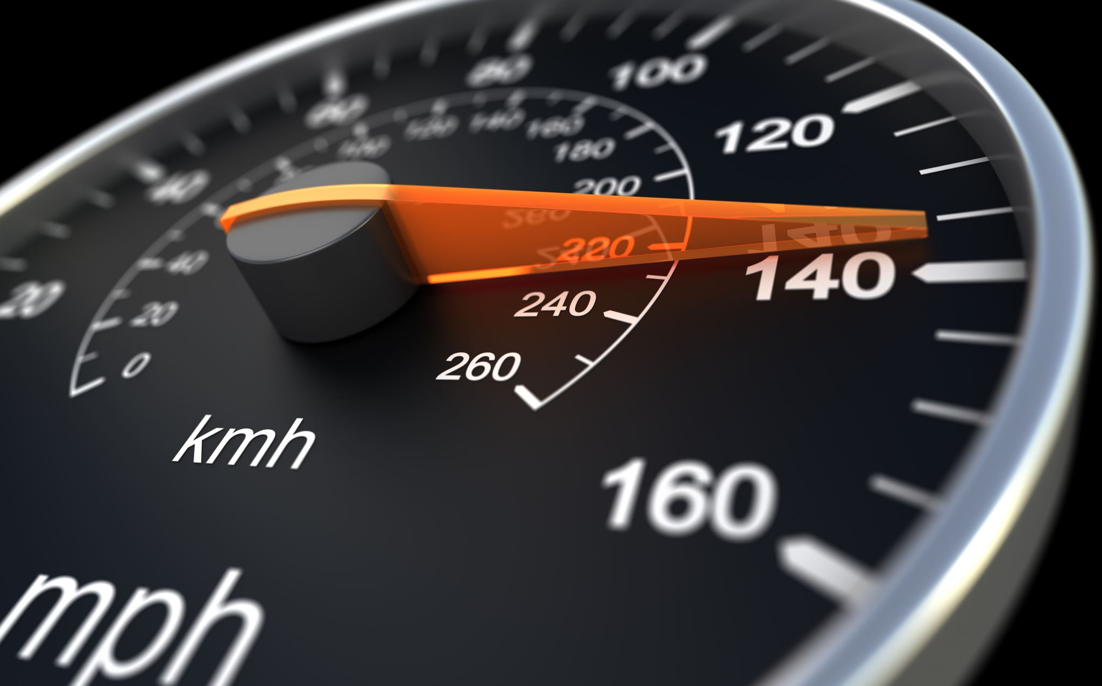
THANK YOU

